Slide 1
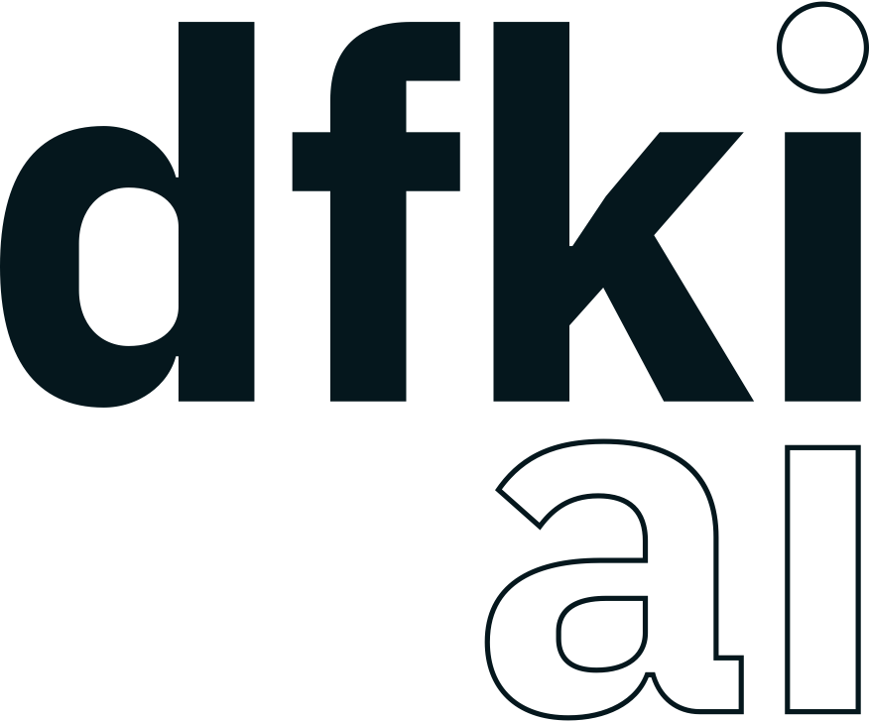


Synergizing Trust and Autonomy: Gaia-X Enabled Multi-Agent Ecosystems for Advanced Freight Fleet Management
Dennis Maecker¹, Felix Harenbrock², Henning Gösling^{1,}, Timon Sachweh³, Oliver Thomas¹
¹ German Research Center for Artificial Intelligence, Osnabrück, Germany
²embeteco GmbH & Co. KG, Rastede, Germany
³ TU Dortmund University, Germany

Slide 2
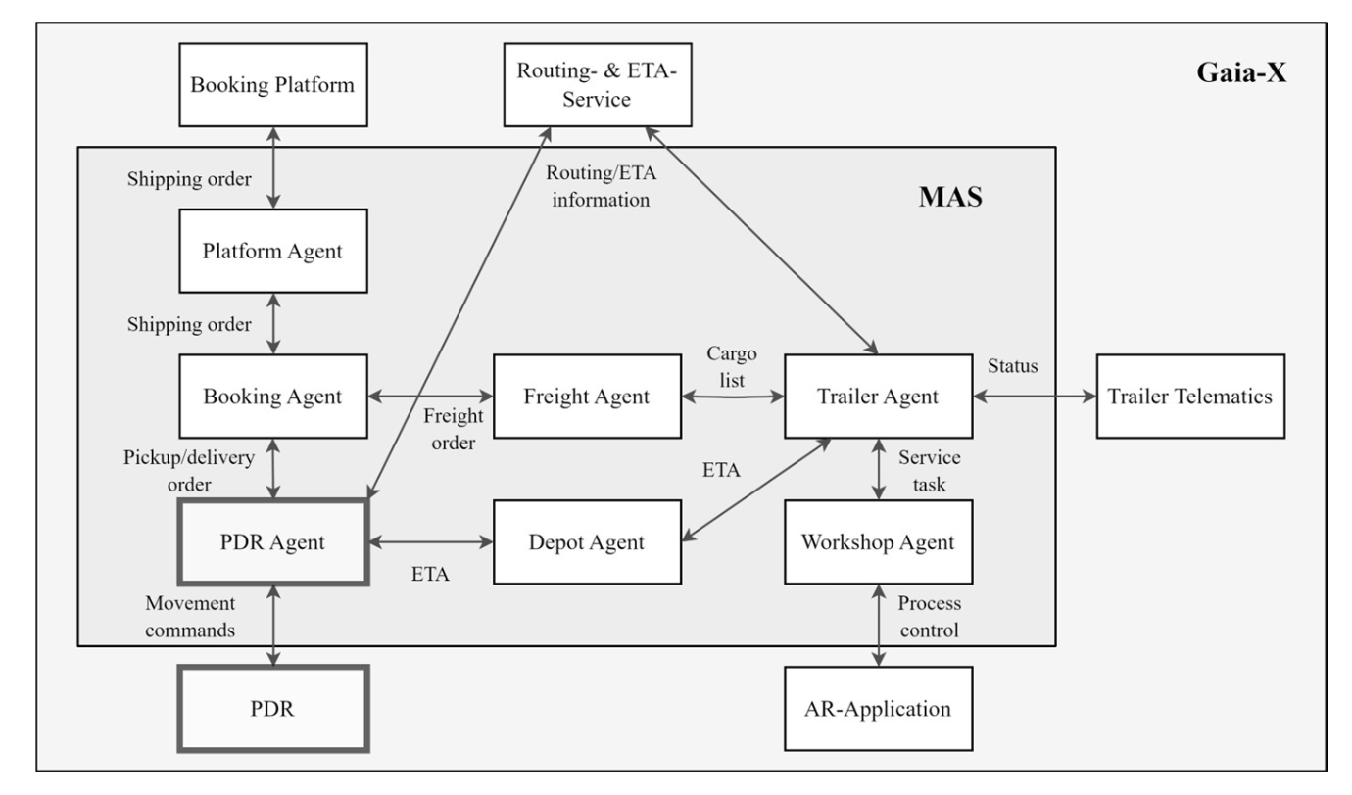
GAIAX 4 ROMS – Freight Use Case MAS System

Slide 3
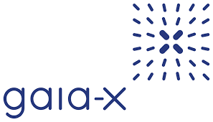
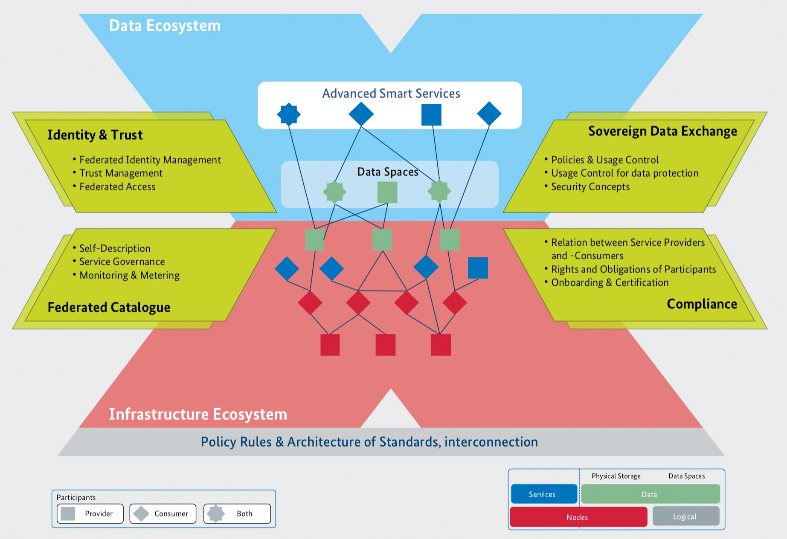
GAIAX 4 ROMS – Freight Use Case MAS System
Gaia-X is a European initiative aimed at fostering innovation through
data sharing
Emphasizing data sovereignty,
Privacy
Security and interoperability
Trust is gained by a trust framework, which sets minimum participation requirements
Cross Federation Service Components (XFSC) providing essential services for a federated data space
Self-Sovereign Identity (SSI) models are used as a secure way to allow individuals, organizations or machines to manage their digital identities and credentials
Decentralized approach

Slide 4
SSI Entities
Decentralized Identifiers (DIDs)
Organizational Credential Manager (OCM)
Globally unique identifiers
Each entity in the ecosystem has one
Technology to establish trust
Manages digital identities of participants
Has all necessary functions for administration of W3C Verifiable Credentials
Creation, issuing presentations and validating
Verifiable Credentials (VCs)
Wallets
Set of claims and metadata
Proves cryptographically who issued it
With both entities are able to have control over their identifiers and associated keys
Is a secure storage for digital credentials
OCM in parts is also a Wallet

Slide 5
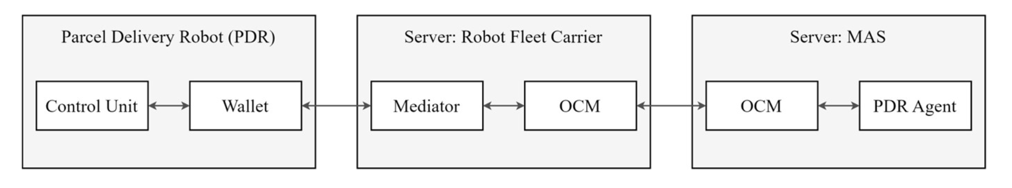
SSI Distributed Service Stack
Hyperledger technology will be used for the open-source SSI development
Aries: protocols and tools for secure peer-to-peer communication and credential exchange
Indy/Askar: contains the blockchain infrastructure for decentralized identity management
The services from Vereign were used (with test installation from British Columbia (Hyperledger Indy)
Each participant (Fleet Carrier and MAS System) need an own OCM
Manages the credentials for the respective organization
Each robot has to hold its own VC, therefore needs a Wallet (Hyperledger Aries Cloud Agent Python)

Slide 6
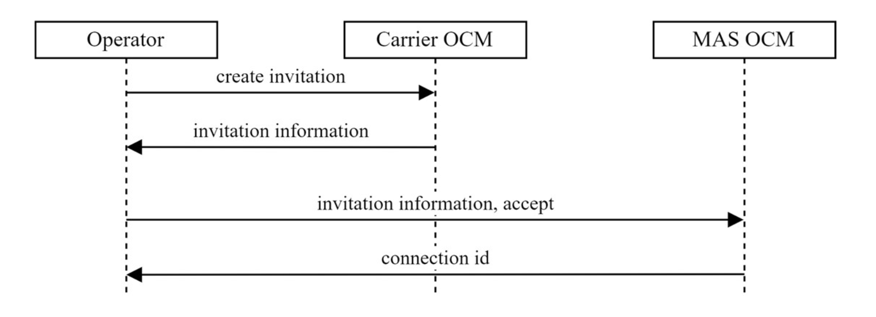
Sample: Setting up connection between two Hyperledger components
Sample process to setup a connection between two OCM instances
Same process is between wallet and mediator / mediator and PDR fleet carrier OCM

Slide 7
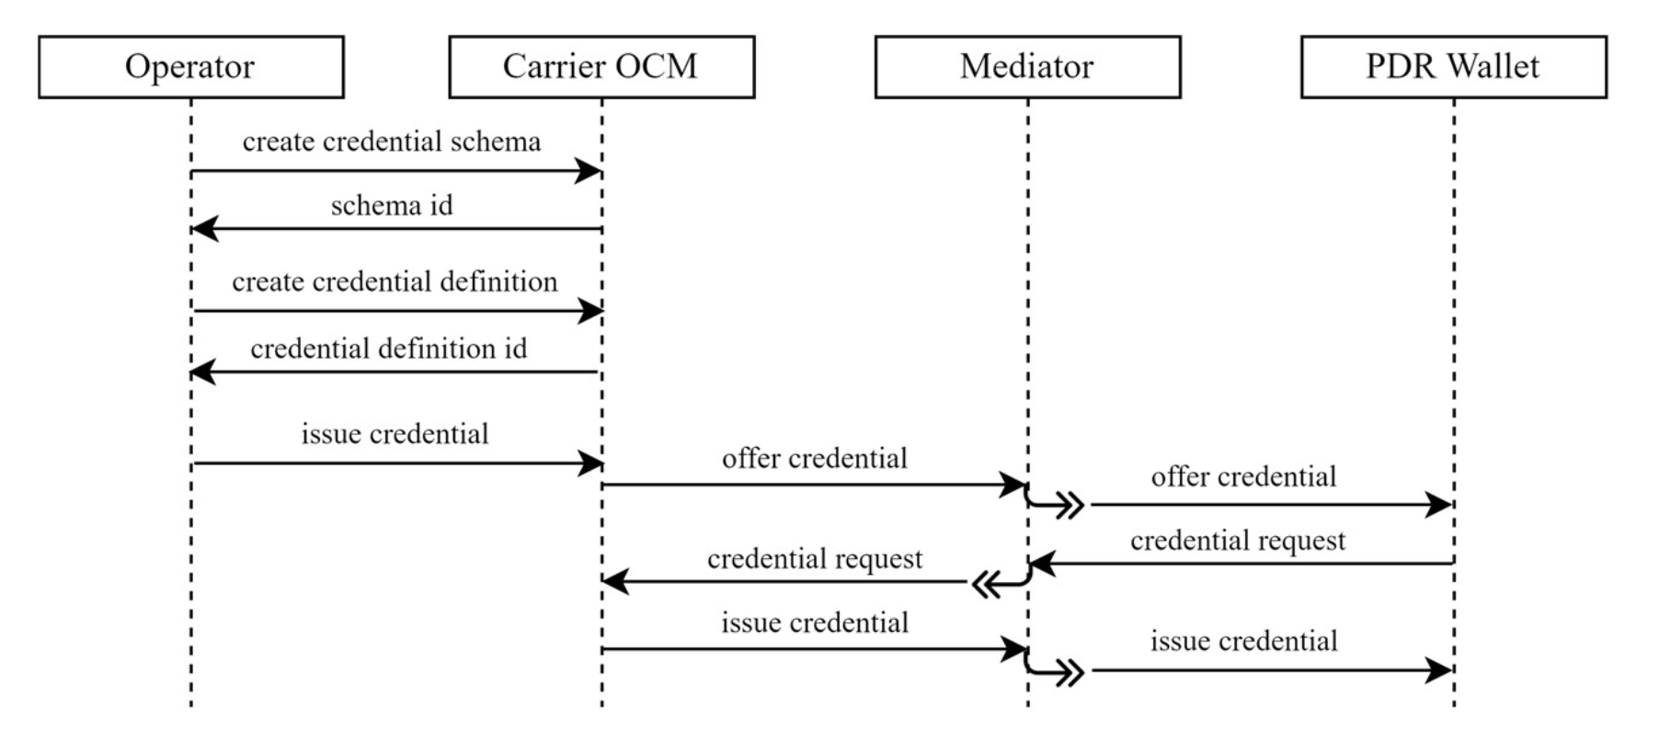
Sample: Issuing of Credentials

Slide 8
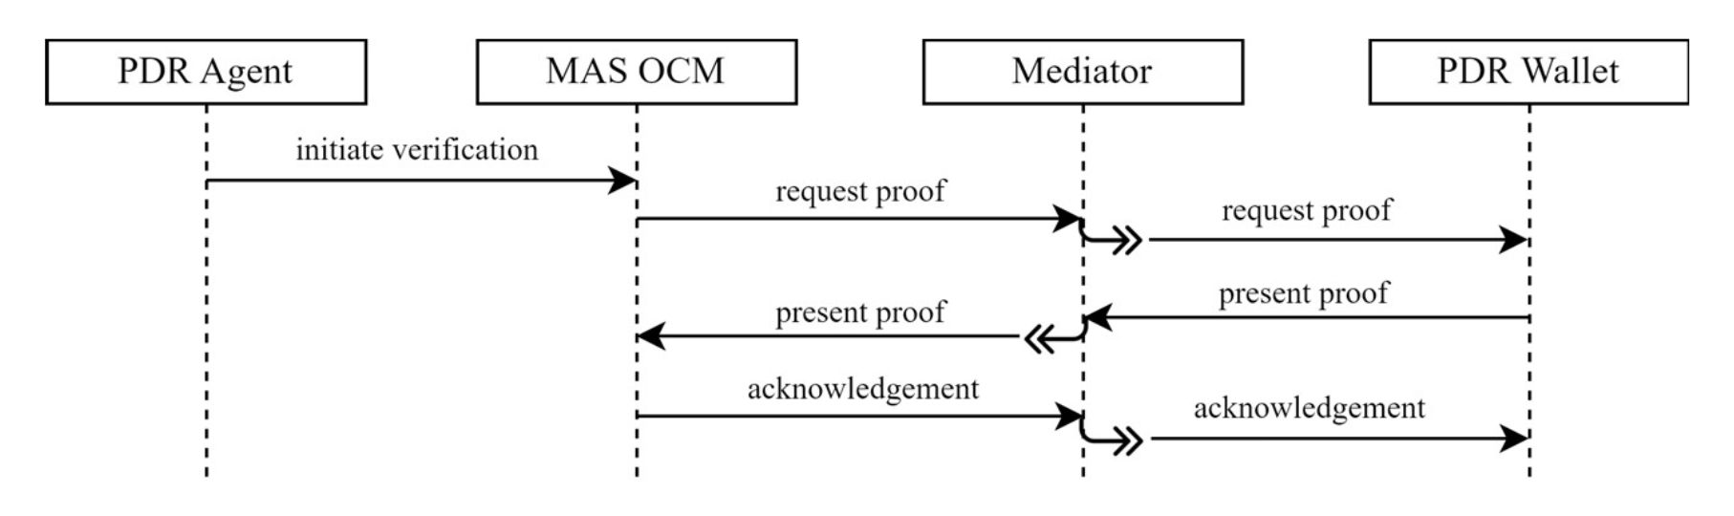
Sample: Verification of Credentials
Wants to verify, that the PDR, which the Agent tries to communicate to, is the one, he pretends to be

Slide 9
Conclusion
We showed, that SSIs with DIDs can enable automatic creation and validation of Verifiable Credentials
Those VCs can be used, to ensure to communicate with right partners inside of federated data spaces like Gaia-X wants to create
SSI in the way, we described, suits well for MAS systems, because of distributed architecture concepts
The demonstrator shows, that the Hyperledger components work for the presented logistic use case, however the approach / technology is not limited to logistics
Furthermore, we want to extend this implementations to integrate Data Space Connectors like IDS or EDC
SSI and EDC combined can become a powerful and automated approach for save and secure data exchange in federated data spaces

